Slide 1
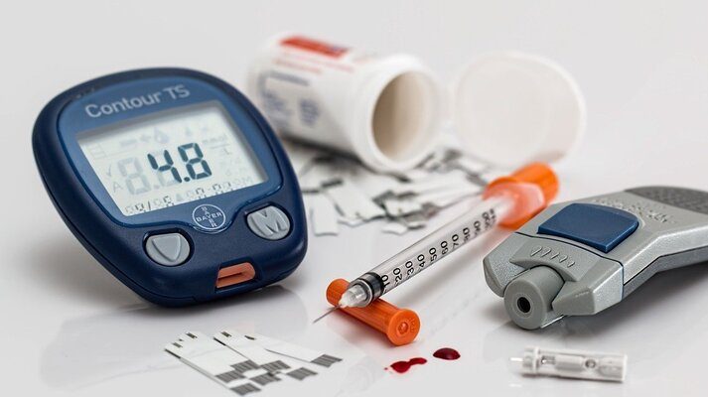
Diabetes Prediction
By: omar kamel
AI Engineering undergraduate student
Supervisor:
Dr.Doaa Mahmoud

Slide 2
Agenda:
Definition and Task Statement
Data Report
Objective Data problems and Cleaning
Exploratory Data Analysis
Modelling and Accuracy

Slide 3
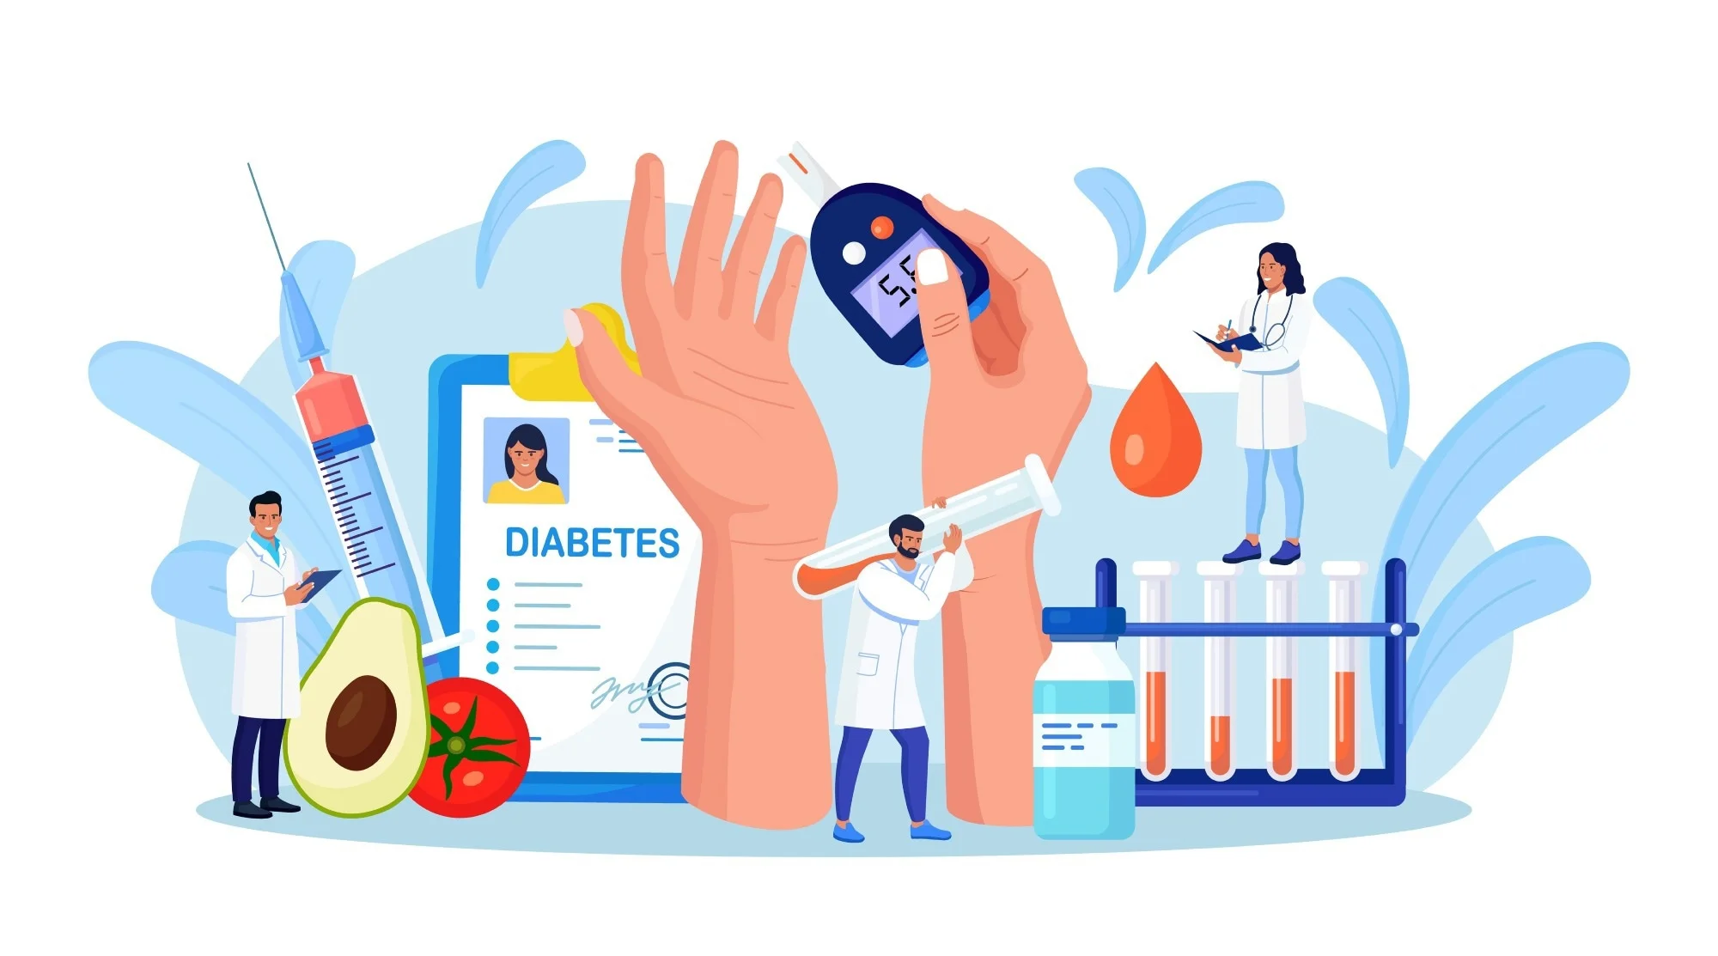
What is the Diabetes
Diabetes is a health condition characterized by high blood sugar levels over a prolonged period. This occurs when there is a deficiency in insulin production (a hormone that helps regulate blood sugar levels) or when the body does not effectively use insulin.

Slide 4
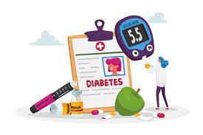
What are the types of Diabetes ?
There are two main types of diabetes:
Type 1 diabetes: It occurs when the pancreas stops producing insulin altogether. Type 1 diabetes patients require daily insulin injections to control their blood sugar levels.
Type 2 diabetes: It occurs when the body is unable to use insulin properly or does not produce enough of it. Treatment for type 2 diabetes may involve lifestyle changes such as diet and exercise, and in some cases, medication to help regulate blood sugar levels.

Slide 5
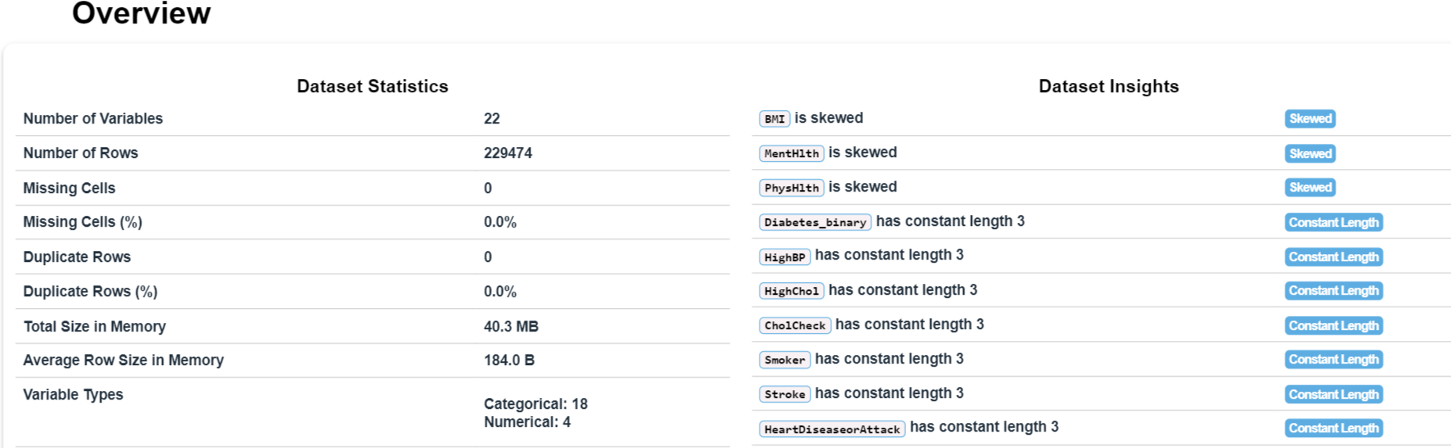
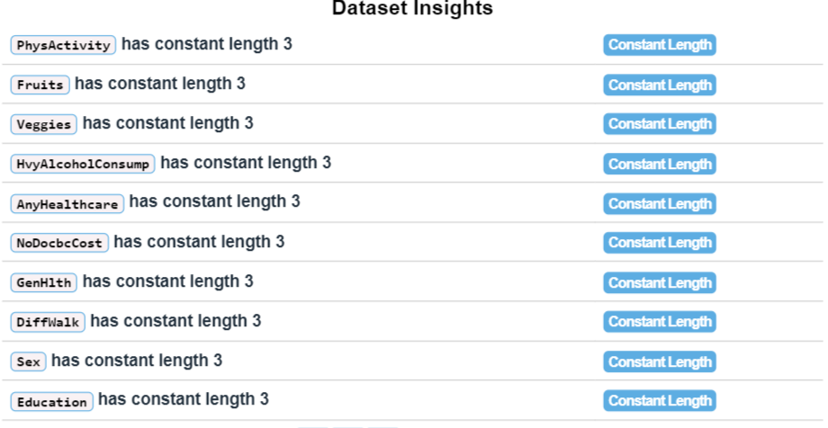
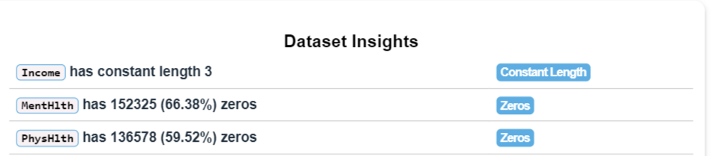
Report

Slide 6
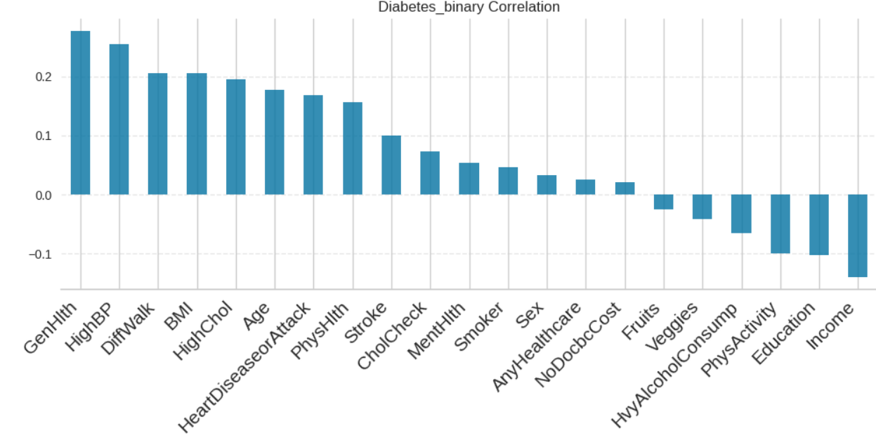
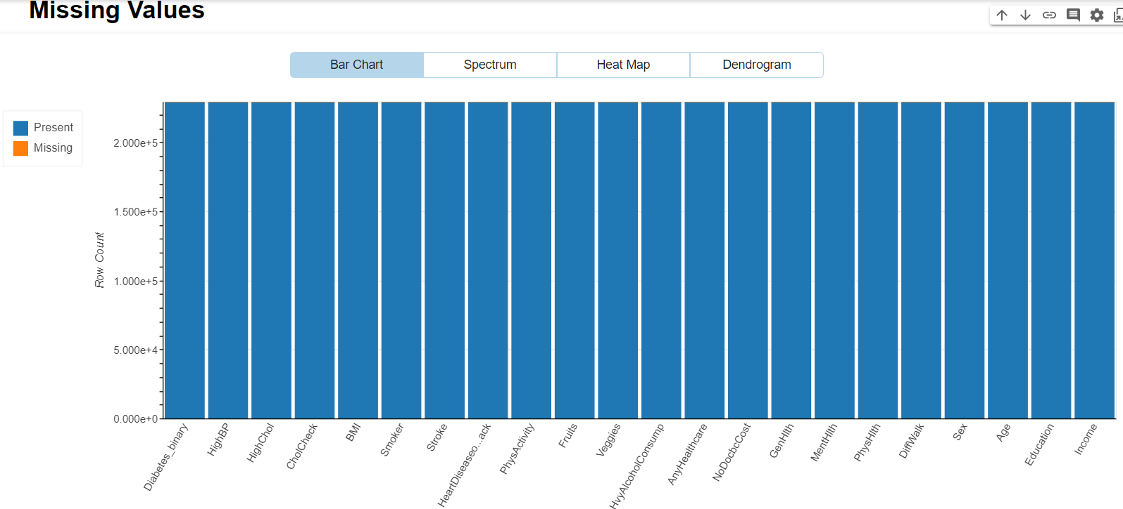
Report
There is no missing value and there is This variables have more correlated with the target variable Diabetes_binary
- GenHlth- HighBP- DiffWalk - BMI -HighChol- Age HeartDiseaseorAttack- PhysHlth- Physactivity- Education-Income

Slide 7
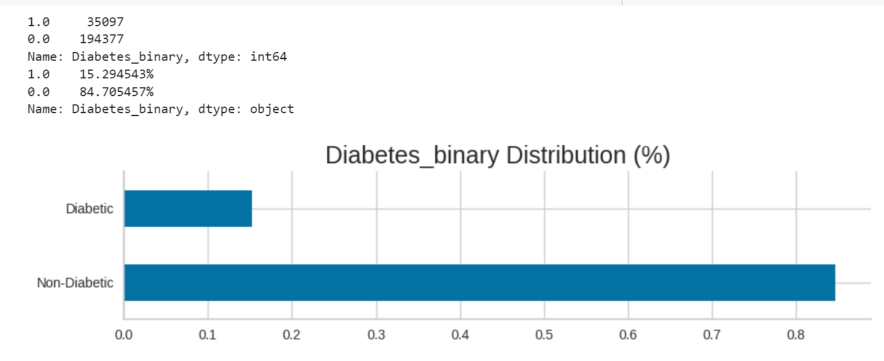
84%of the Data is Non-Diabetes and 15%have Diabetes

Slide 8
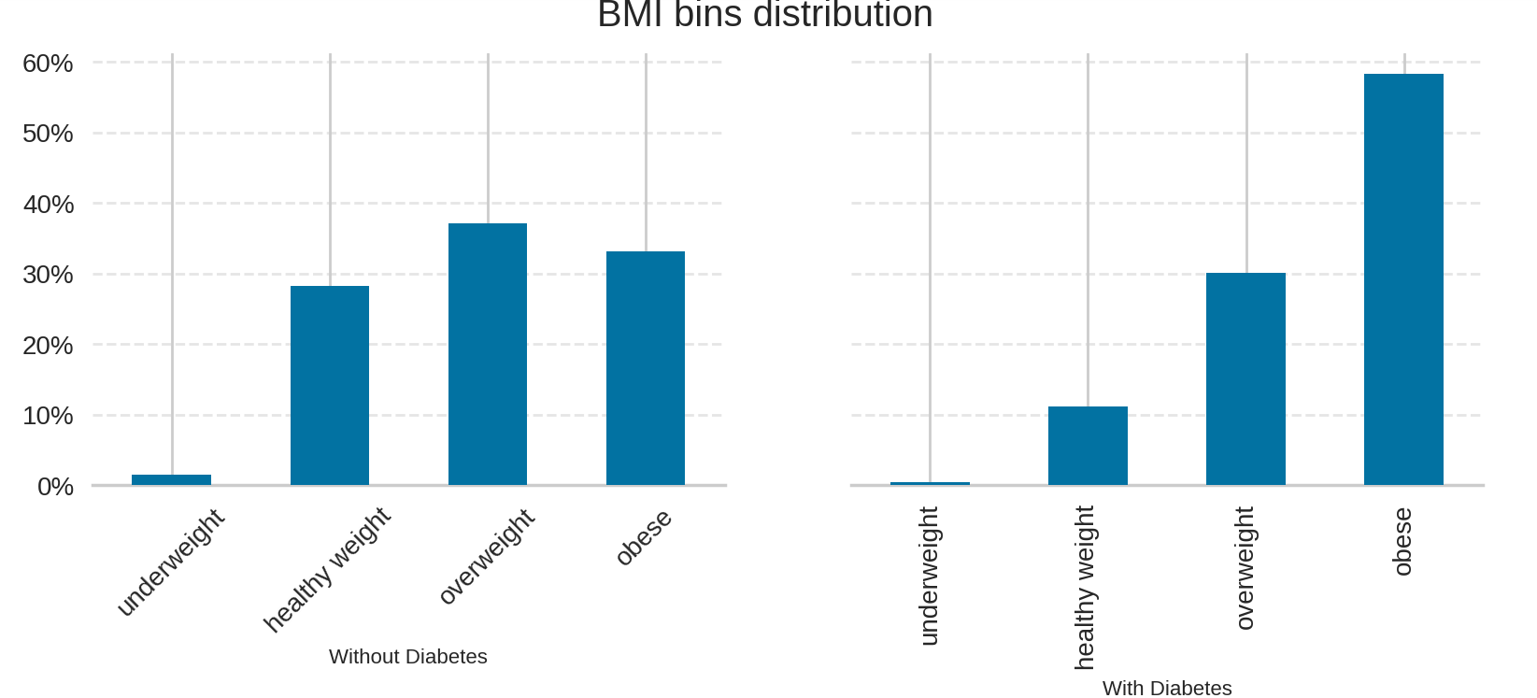
1:BMI
Feature Exploration Feature Problem
BMI
Body Mass Index (BMI) is a measure of body fat based on a person's weight and height. It is calculated by dividing a person's weight in kilograms by the square of their height in meters (kg/m²).
BMI=weight (kg)height2 (m2)
BMI provides an estimation of the amount of body fat a person has, and is commonly used as a screening tool to identify individuals who may be at a higher risk for weight-related health problems, such as diabetes, heart disease, and certain types of cancer.
How is BMI interpreted for adults?
How is BMI interpreted for adults?
According with CDC:
For adults 20 years old and older, BMI is interpreted using standard weight status categories. These categories are the same for men and women of all body types and ages.
If your BMI is less than 18.5, it falls within the underweight range.
If your BMI is 18.5 to 24.9, it falls within the Healthy Weight range.
If your BMI is 25.0 to 29.9, it falls within the overweight range.
If your BMI is 30.0 or higher, it falls within the obese range. A new column was created with this range names.

Slide 9
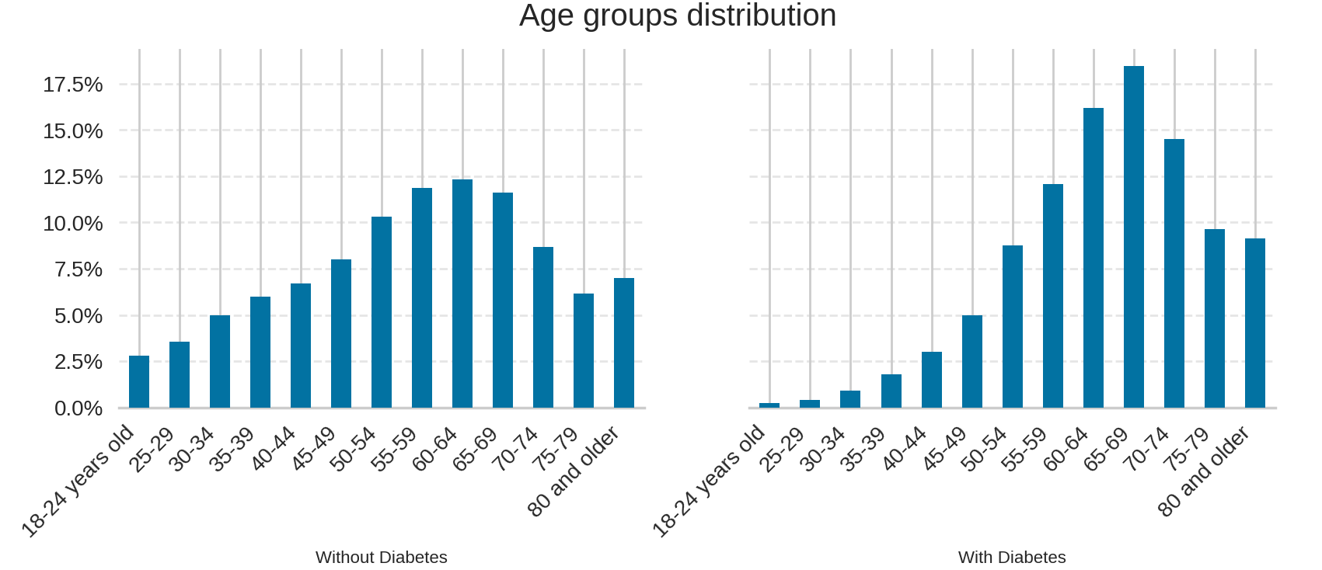
2:Age
People who have diabetes, their ages range from 65-69, so older people are more susceptible to the disease

Slide 10
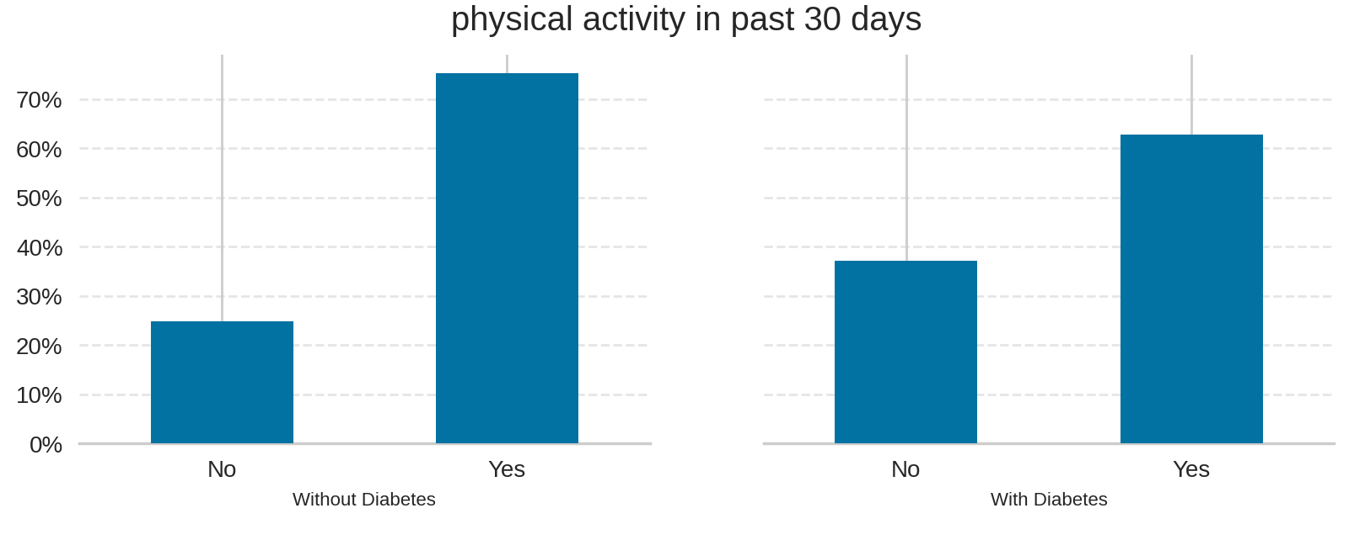
3:PhysActivity
Whether he has Diabetes or not, he is exercising away from his work

Slide 11
Modelling
Before we make the model, we have to balance the data, so we will use a method RandomOverSampler
By using RandomOverSampler, the number of instances in the minority class is increased, which helps improve performance and balance in models based on this data.
This algorithm can be used with various types of machine learning models, such as artificial neural networks and other statistical methods.
After we used RandomOverSampler, the data remained 388754

Slide 12
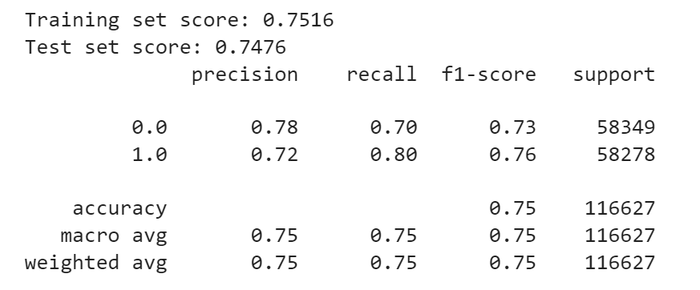
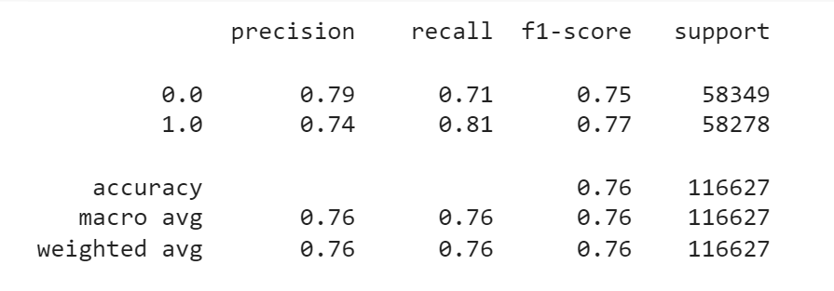
Modelling
1:Rondom Forest
2:XGBoost

Slide 13
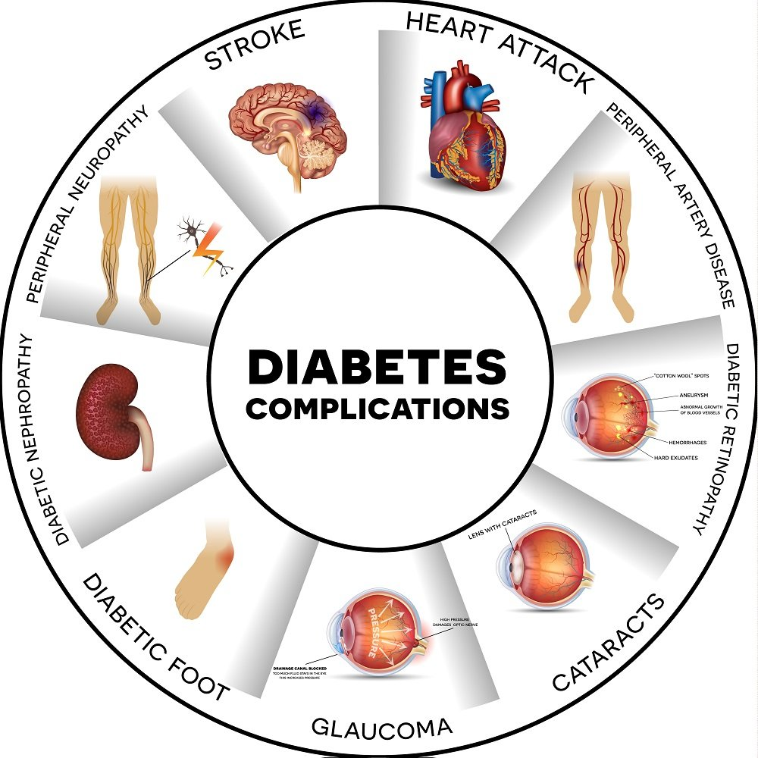
Now that we've manipulated the data and explained what diabetes is, we've struck a balance in the data. This is a summary:
1: Diabetes is a serious disease, and we must deal with it early. We must pay attention to health, and it is considered the main factor after the genetic factor.
2: To reduce the susceptibility to infection, we must take care of our life system and stay away from the factors that affect our health

Slide 14

Special Thanks to Dr.Doaa Mahmoud for her support, amazing help The best of luck to her from the bottom of my heart.

